Slide 1
Automated measurement of laser wavelength using Michelson interferometer
Mykhail rubtsov

Slide 2
The purpose of the project
The purpose of our project is an automated measurement of the laser wavelength using a certain technique, automation of the measurement process is very important, because measuring certain quantities by eye can lead to a significant increase in the measurement error.

Slide 3
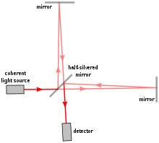
What is a Michelson interferometer?
Michelson interferometer is a scheme for observing the phenomenon of light interference created in 1887 by the American physicist Albert Michelson.

Slide 4
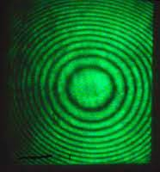
About interferometry methods
Interferometry methods allow you to use a fairly simple technique, and at the same time get very accurate results at the nanoscale. So we can measure the wavelength of the laser with quite a lot of accuracy.
Interference pattern

Slide 5
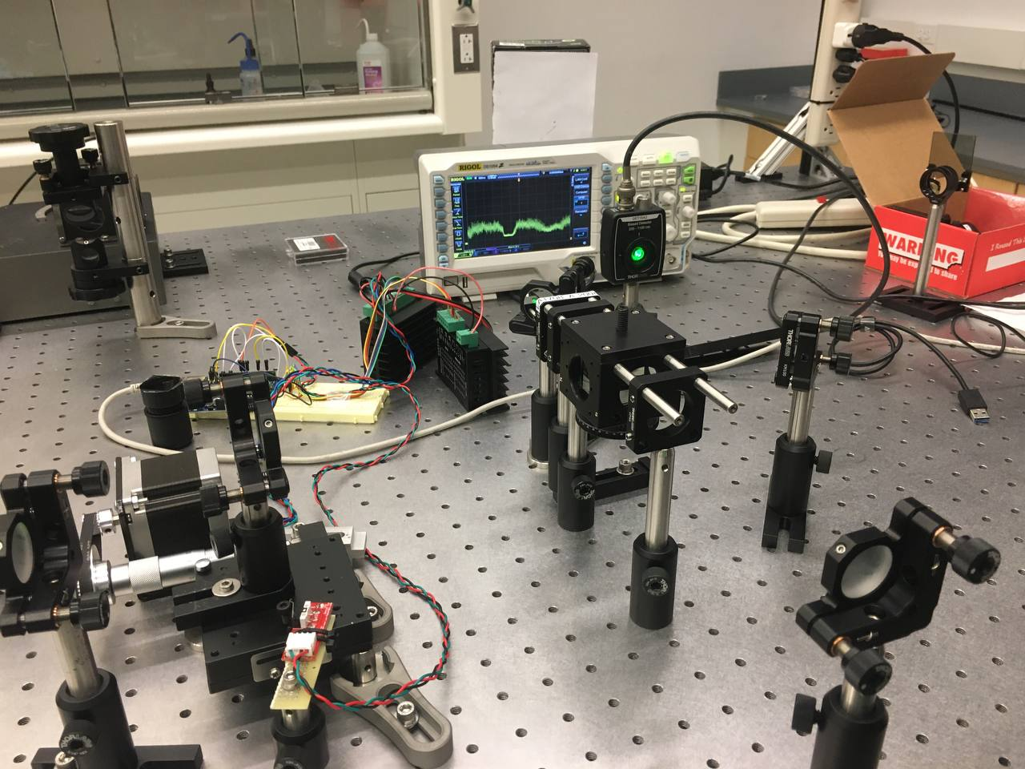
Laser wavelength measurement methods
We also used a stepper motor and oscilloscope to measure the laser wavelength. Gradually moving one of the mirrors forward, the interference pattern changed, by this change we calculated the laser wavelength, namely by this formula:
$\text{λ}$=$\frac{\text{2}\text{Δ}\text{x}}{N}$
Where λ is the wavelength of the laser; Δx - mirror displacement;
N is the number of maxima passed through the center.

Slide 6
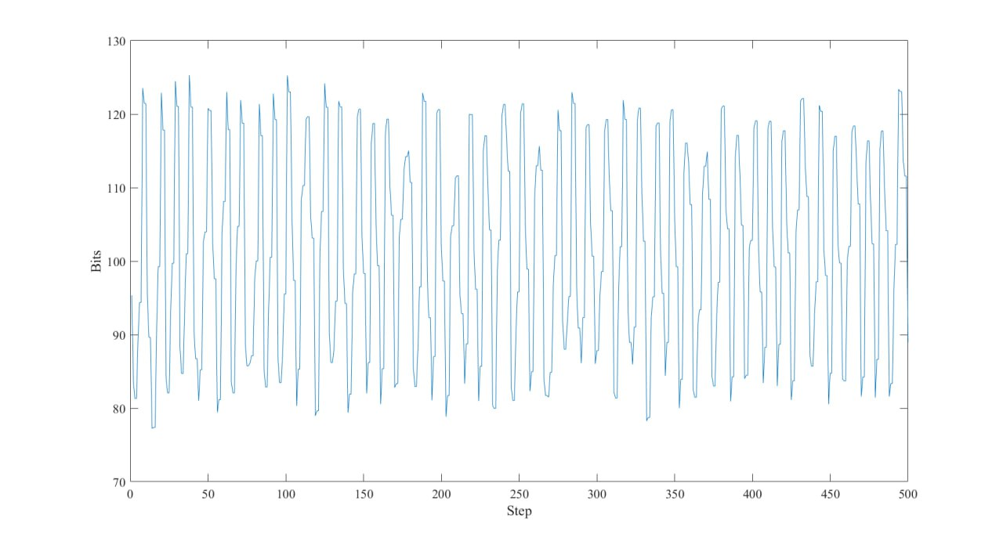
Plot of light intensity dependence on photodetector depending on mirror displacement

Slide 7
Calculations
Arithmetic mean of laser wavelength:
$\overline{x}=\frac{\sum_{i=1}^{n}{x_{i}}}{n}=\frac{531.8nm+533.3nm+523.9nm+523.8nm+525.6nm}{5}≈527.7nm$
Mean square deviation of laser wavelength:
$$σ=\sqrt{\frac{\sum_{i=1}^{n}{{(\overline{x}−x_{i})}^{2}}}{n(n−1)}}=$$
=$\sqrt{\frac{{(527.7nm−531.8nm)}^{2}+{(527.7nm−533.3nm)}^{2}+{(527.7nm−523.9nm)}^{2}+{(527.7nm−523.8nm)}^{2}+{(527.7nm−525.6nm)}^{2}}{20}}≈$2nm
Average absolute error of laser wavelength:
$$∆x=σt=2nm∗2.776≈5.6nm$$
Where t is Student's distribution (in our case for 95% confidence interval)
Average relative error of laser wavelength:
$$ε=\frac{∆x}{\overline{x}}=\frac{5.6nm}{527.7nm}≈0.01$$

Slide 8
Results
So we made 5 measurements and got the results according to this graph. (The orange line in the graph is the arithmetic mean of the laser wavelength)

Slide 9
Conclusion
—We automated Michelson interferometer to automatically measure laser wavelength;
— We got fairly accurate results:
$$λ=527.7nm±5.6nm$$
Relative error was only 1%

Slide 10
Thank you for attention!
Thank you for attention!

