Slide 1
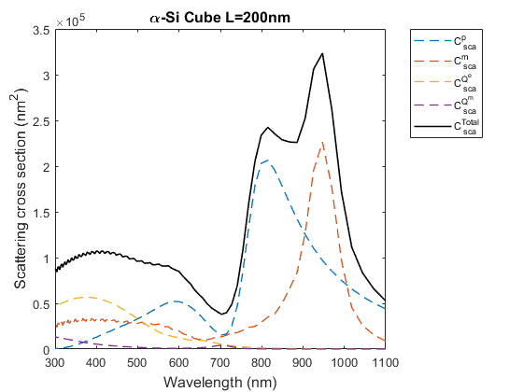
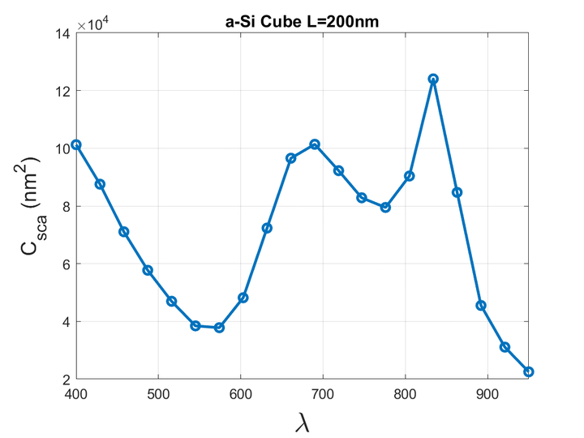
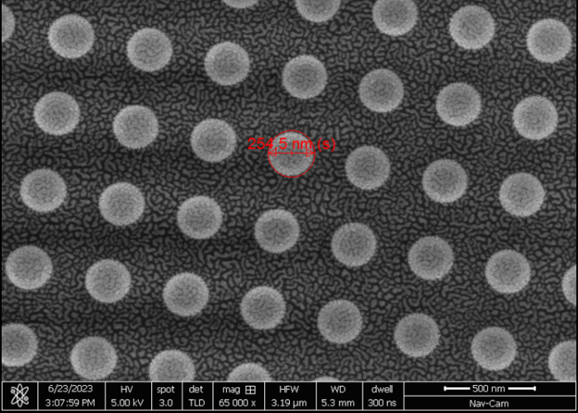
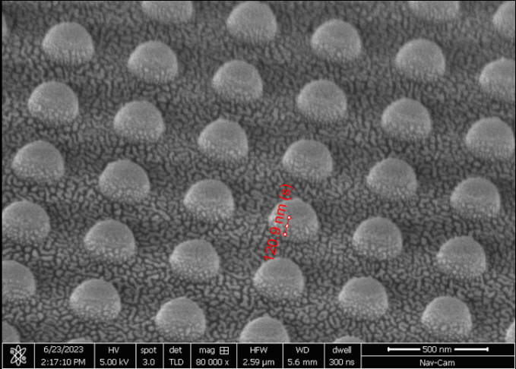
Amorphous silicon nanostructures scattering
Bohdan Filonenko, Korosko Andrii, Matthew Sfeir, Anton Kyrylenko
Introduction
From a scientific point of view, it is necessary to study the properties of semiconductor metamaterials for energy harvesting. Our task was to find a fast, accurate method for the underlying structure. We made an assumption that the DDSCAT program using the DDA method can be used for our purposes. The next step is to compare the simulation program with the one what is already using
Advantages and disadvantages: the program is free; undemanding to power, suitable for a computer with a bad figure; good for simple shapes, but bad for more complex ones; it simulates a limited number of structures
Methods
Results
The discrete dipole approximation is a technique used to model the scattering of light or other electromagnetic waves by small dielectric or metallic objects. This method is based on the representation of an object as a discrete set of dipoles, each of which interacts with an incident electromagnetic field and with other dipoles.
We used amorphous silicone with refractive index 4.3
The wavelength was chosen to be as similar as possible to ordinary sunlight.
Graph 1
Graph 2
We got two graphs Graph 1 created with FTDT, the second with DDSCAT
The next step is to compare the simulation program with the FTDT currently in use.
Conclusion
From graph 1 and graph 2 it can be seen that the drawings are very similar, which means that this simulator can be used to work with these materials
We learned to use the Fortran programming language, studied light matter/scattering, ramen nuddle, data processing/analisys, also improved the level of academic English
Gained experience by joining to research group of scientists

